Slide 1


Space Invaders
ING. Miguel Ángel Pancha
ING. Erick Duque
ING. Valentina Rozo
Group Nº3

Slide 2

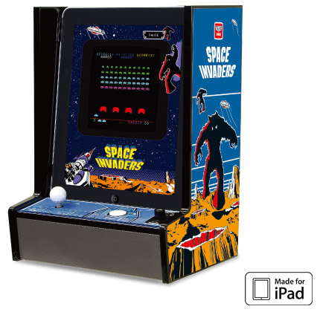
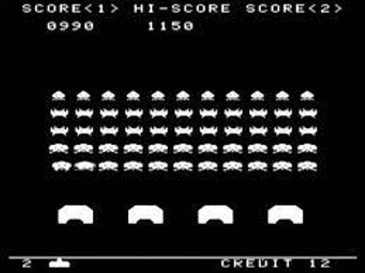
context

Slide 3
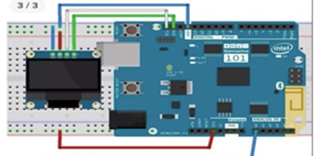
materials and connections
Some of the materials that were thought to be used for the implementation of the project are:
-LCD display
-Arduino mega board
-Protoboard
- Joystick
-Push buttons
-And others....

Slide 4
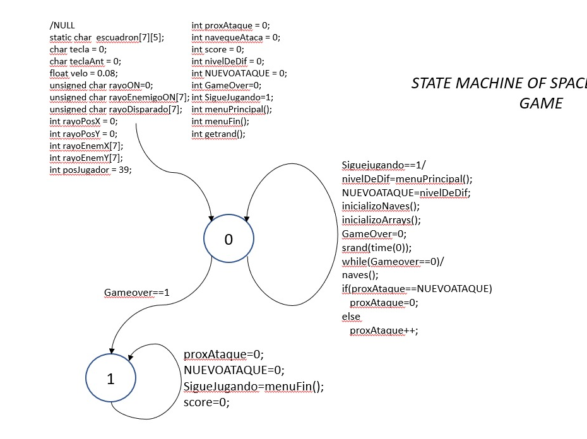
Finite State Machine Diagram

Slide 5
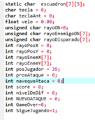
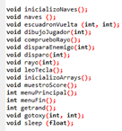
code

Slide 6
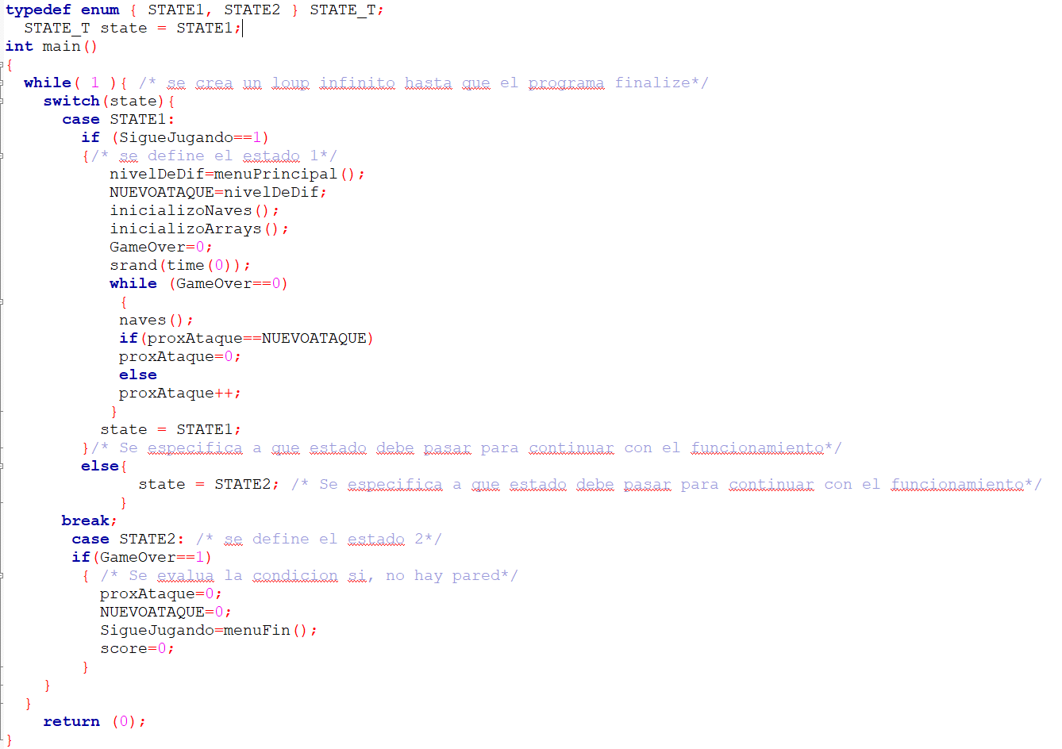
Code

Slide 7
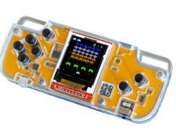
ideal implementation

Slide 8
conclusions
- From this project it was possible to conclude that through the use of functions and the use of concurrent finite state machines, it is possible to create a video game based on these concepts, making the source code compact and efficient at the time of its execution.
The program was configured in such a way that it would completely evaluate the status of such action, so that it could perform the same action later after a refresh time.
Considering that the construction of the Code is clear and concise, it can be understood by anyone who wishes to use the Code in an academic manner.

Slide 9
WebGrafia
[1] Quesada, E. (s. f.). Máquinas de estados y automatas. https://www.escinf.una.ac.cr/discretas/Archivos/Presentaciones/Capitulo_7.pdf
[2] Space Invaders: conoce la historia del clásico juego en su cumpleaños 40 | tecno.americaeconomia.com | AETecno - AméricaEconomía. (s. f.). tecno.americaeconomia.com | AETecno - AméricaEconomía. https://tecno.americaeconomia.com/articulos/space-invaders-conoce-la-historia-del-clasico-juego-en-su-cumpleanos-40
[3] Descripcion de funcionamiento de un LCD | Samsung Latinoamérica. (s. f.). Samsung latin. https://www.samsung.com/latin/support/tv-audio-video/how-does-the-lcd-display-work/
[4]¿Como Funciona un Joystick? (s. f.). Ordenadores y Portátiles. https://www.ordenadores-y-portatiles.com/joystick/

